Slide 1

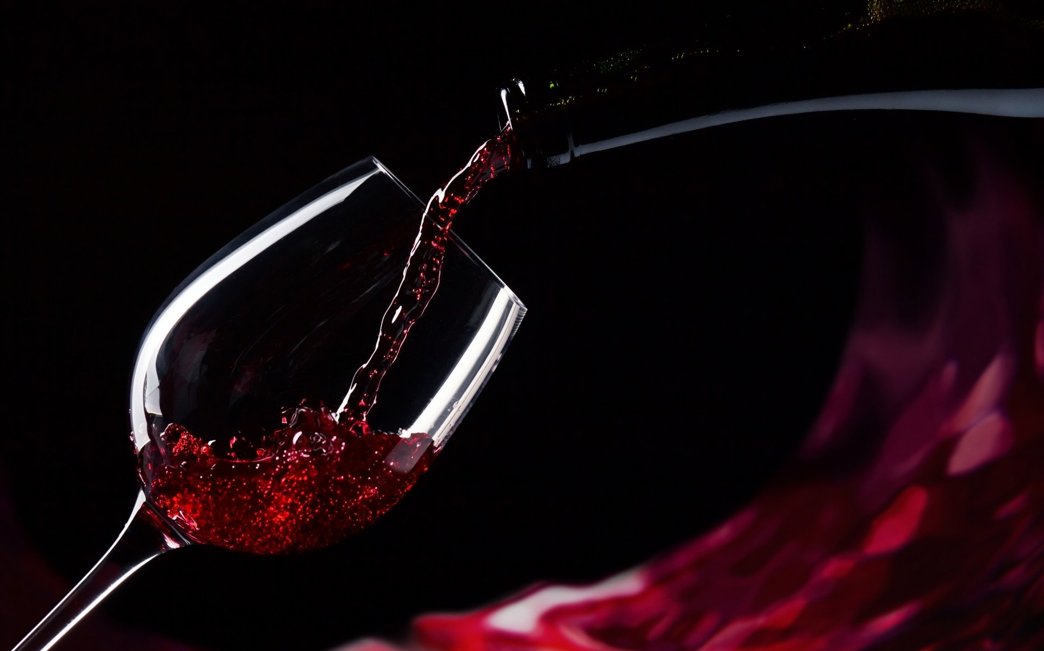
Red Wine Quality Predictors by The Three Musketeers

Slide 2

Autumn Heyman
Introducing the Pantone Color of the Year 2022. PANTONE 17-3938 Very Peri is a dynamic hue that blends the faithfulness and constancy of blue with the energy and excitement of red.
The four color palettes in this template feature Very Peri to help you express your ideas and convey the right mood. Read on to learn how to use these colors in any presentation.

Slide 3
Erin WeaveR
Introducing the Pantone Color of the Year 2022. PANTONE 17-3938 Very Peri is a dynamic hue that blends the faithfulness and constancy of blue with the energy and excitement of red.
The four color palettes in this template feature Very Peri to help you express your ideas and convey the right mood. Read on to learn how to use these colors in any presentation.

Slide 4
Georgia Miller
Introducing the Pantone Color of the Year 2022. PANTONE 17-3938 Very Peri is a dynamic hue that blends the faithfulness and constancy of blue with the energy and excitement of red.
The four color palettes in this template feature Very Peri to help you express your ideas and convey the right mood. Read on to learn how to use these colors in any presentation.

Slide 5
Project Introduction & Background
You should have a couple slides of background information about the topic you are covering. For instance, if you are asking and answering questions about the stock market, you should give a little basic information about the stock market.
Try to build this up, so start with the most general information and then get more specific with information that directly relates to your data or the questions you will be answering with the data.

Slide 6
Wine Quality
Subjective
Objective

Slide 7
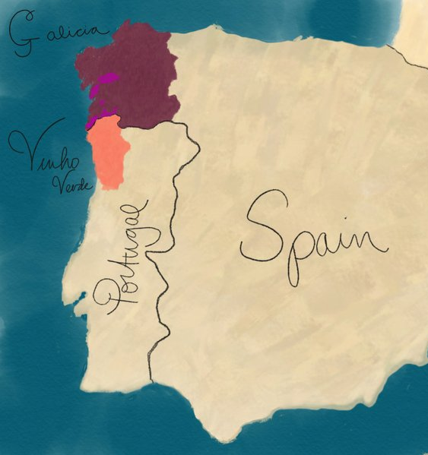
Wine region
Vinho Verde
Alvarinho & Loueiro
Amaral, Borraçal
Galicia
Albariño
Mencía

Slide 8
The DataSet
Study conducted by
Quality score was determined by
Scale
Distribution

Slide 9
Questions
Which physiochemical properties of wine have the greatest impact on wine quality?

Slide 10
METHODS
Next comes your methods section. This is where you talk about all of the details regarding your data. You want to give a very high level overview of what you did to:
Gather/find data
Manipulate / wrangle data
Create new variables
You also want to paint a picture of what your data is like. Include details such as:
Important variables and their summary statistics
Sample size
The methods section should only be a few slides, and should not include any code. You are presenting to a wide, non-data science audience, and thus should not go into a lot of detail.

Slide 11
Results
The results section will be the meat of your presentation. You should divide your results section into parts by evaluation question, so that you can easily signpost things. In the results section, you will go over any of the exploratory findings you have you want discuss, as well as the answers to each evaluation question. Ensure that you provide LOTS of beautiful visuals to go along with your findings.

Slide 12
Summary
The summary should be JUST ONE SLIDE, and it should contain a summary of the entirety of your results section. It should be in layman's terms, quick and dirty.

Slide 13
Conclusions
Your conclusion section should also only be one slide long. In it, you should have some bullet points containing information about:
How do your findings impact the world at large?
What's important about this work?
Big picture information

Slide 14
Questions
Your presentation should conclude with a questions slide. All it needs to say is "Questions?" and it helps signify the end of the presentation and the beginning of the question and answer section of your big day. You should be prepared for questions like these:
If you had more time, what else would you do on this project?
What's next for you?
What was the most difficult part of this project?

